Slide 1
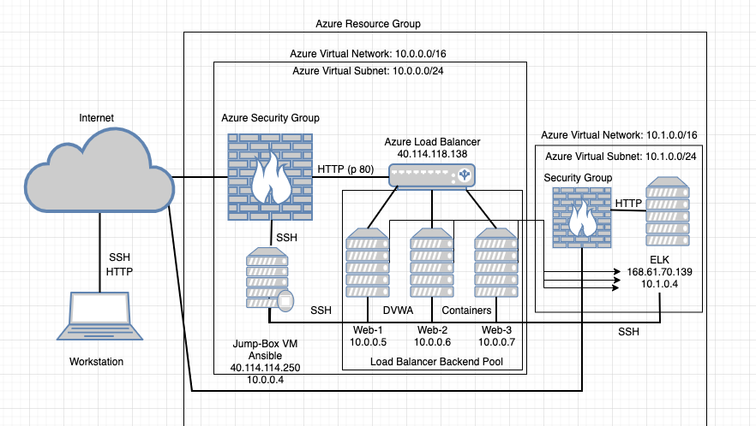
Red Team Resource Group
Red Team Virtual Network:10.1.0.0/16
Red Team Virtual Subnet: 10.1.0.0/24
Red Team NSG
ELK Virtual Network:10.2.0.0/16
Red Team Load Balancer
52.142.49.139
ELK Virtual Subnet: 10.2.0.0/24
ELK NSG
20.122.199.195
10.2.0.4
10.1.0.5 10.1.0.6 10.1.0.7
40.121.92.231
10.1.0.4

